Slide 1
Agriplex Maize Public Marker Panel: Background and Initial Observations
Shawn Kaeppler and UW Corn Breeding Team
University of Wisconsin-Madison

Slide 2
Data analysis team
Dylan Schoemaker
Dayane Lima
John Searl
Alden Perkins
In collaboration with Beni Kaufman

Slide 3
Primary goals and uses of marker set
Cost-effective marker set for genomic prediction and selection in large sets of material
Additional uses:
Genetic mapping
Quality control and identity detection

Slide 4
Sources of SNPs
Chose markers that segregated among diverse US Dent maize
Markers were identified in one of two previously developed SNP sets:
Stiff Stalk: Exome capture derived SNPs from Michel et al. (2022) that also segregated in whole genome resequencing of a diversity panel (Qiu et al. 2021)
Non-Stiff Stalk: Dual enzyme GBS derived SNPs
Stiff Stalk Multi-parent Population
* MAGIC of PHJ40, NKH8431, PHB47, B73, B84 and LH145
Non-Stiff Stalk Factorial Populations
* Factorial population involving crosses of 3IIH6, LH185, LH182, W606S X PHK76, PHN46, and PHP02
Michel et al. 2022. Genetics 221:iyac063
Qiu et al. 2021. G3 11:jkab238
Notes:
Values in parentheses, number of individuals after cleaning the data. Before clean: 3IIH6_PHK76 175
3IIH6_PHN46 178
3IIH6_PHP02 137
LH185_PHK76 177
LH185_PHN46 177
LH185_PHP02 149
LH82_PHK76 167
LH82_PHN46 165
LH82_PHP02 152
W606S_PHK76 144
W606S_PHN46 169
W606S_PHP02 169

Slide 5
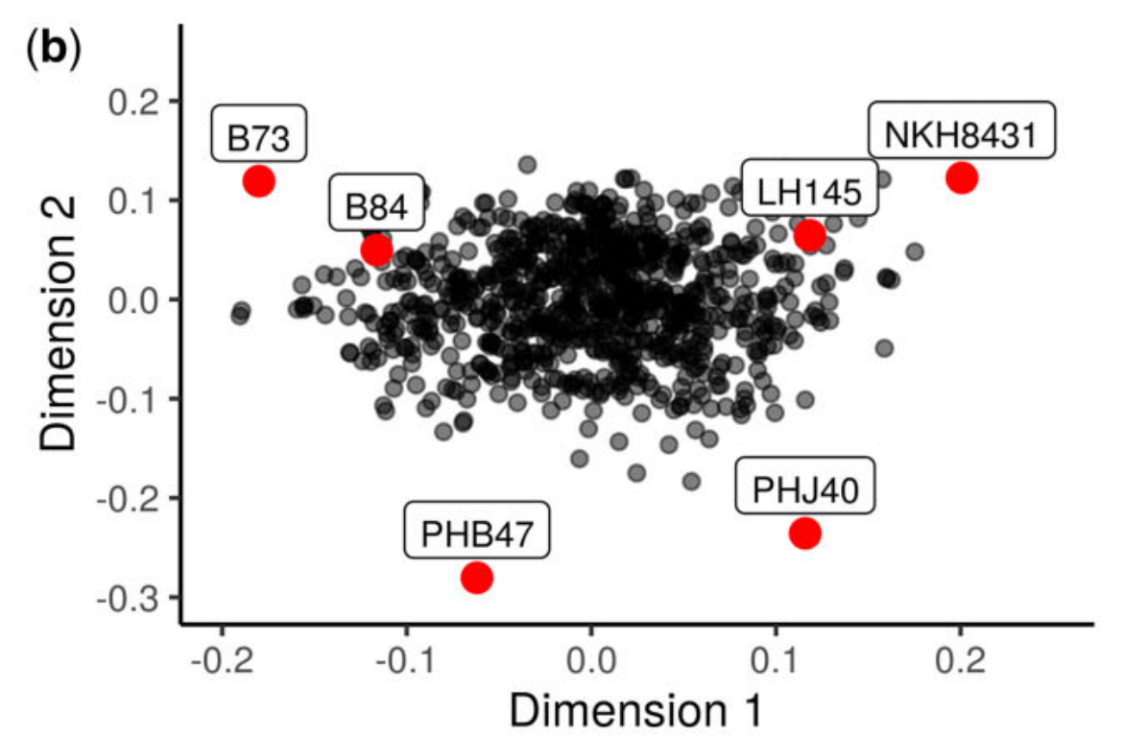
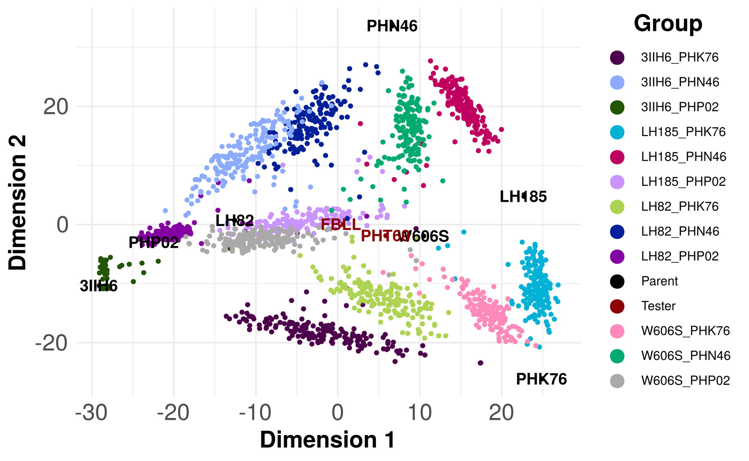
Marker selection
Analysis of hybrid yield; inbred and hybrid flowering time and height; ear, cob, and kernel characteristics; and tar spot resistance
QTL mapping to identify SNPs associated with traits of interest
Ridge regression to identify SNPs with large effects
Stiff Stalk Multi-parent Population
Non-Stiff Stalk Biparental Populations
Notes:
Same slide but with PCA instead of table

Slide 6
Potential markers submitted to Agriplex
3,688 SNPs submitted to Agriplex: 2,500 priority and 1,188 alternates
Initial informatics selection by Agriplex and empirical test
Data returned for 2,491 markers in first contracted experiment
 | Stiff Stalk | Non-Stiff Stalk
Priority | 1,480 | 1,020
Alternates | 832 | 356

Slide 7
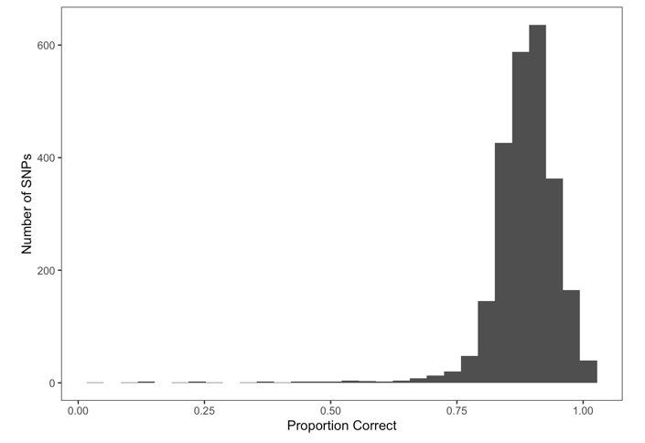
Preliminary evaluation - 188 diverse maize lines
Results: 92% concordance with previous GBS data and 93% technical repeatability
Grouping of 188 inbred lines
Inbred Line Grouping | Count | Percent
Iodent ex-PVP & Proprietary | 17 | 9
NSS ex-PVP & Proprietary | 30 | 16
SS ex-PVP & Proprietary | 41 | 22
Public and GEM | 42 | 23
WI Breeding Lines | 56 | 30

Slide 8
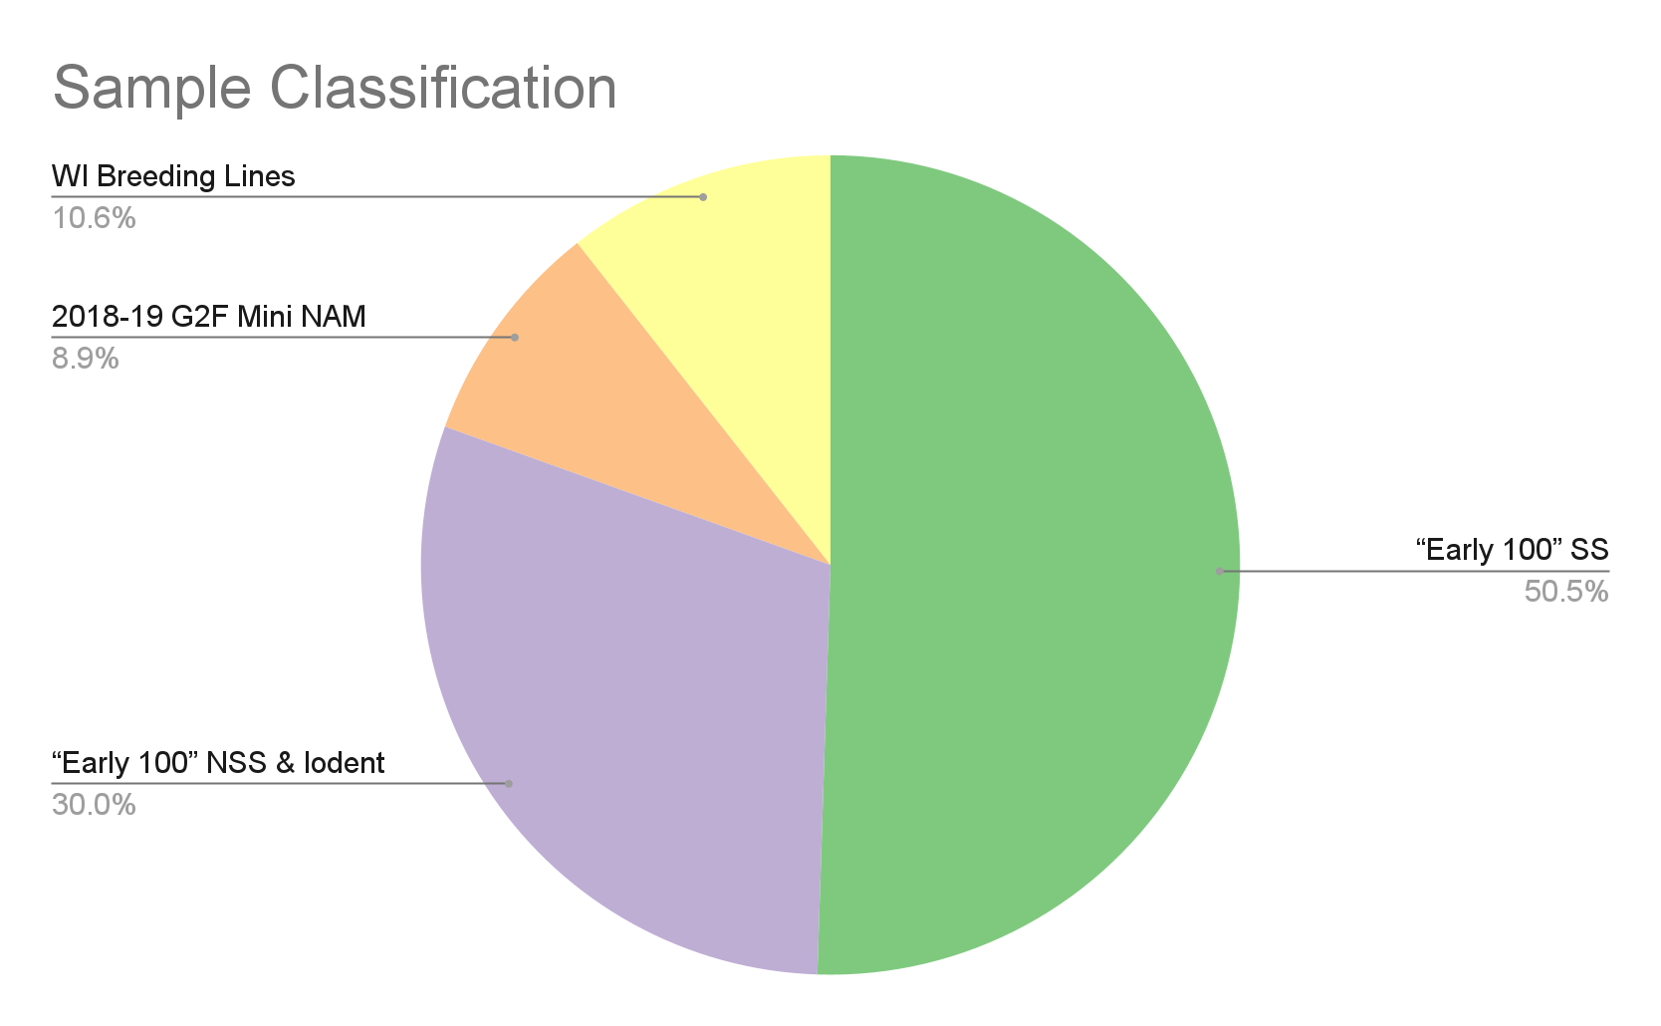
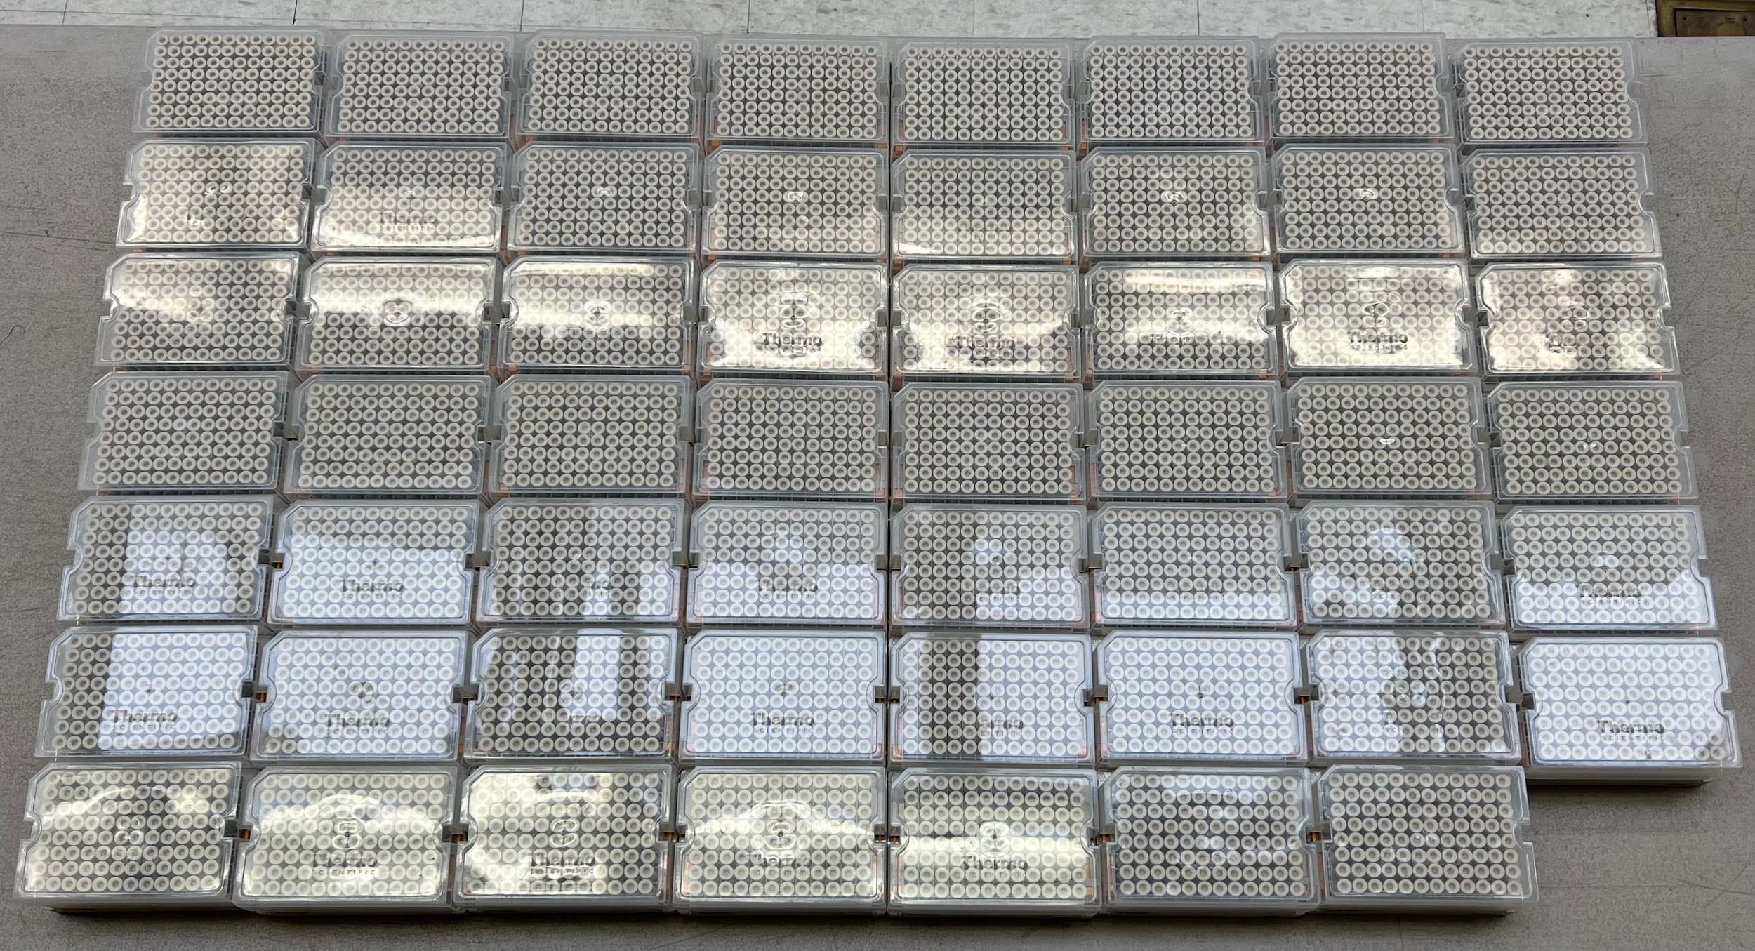
Submission of 5,088 experimental samples
WI Breeding Lines
G2F Mini-reference set
SS GS “Early 100”
NSS GS “Early 100”

Slide 9
Submission Procedure
Field Sampling: 4,095 Samples in 3 days
MIDCO Global ⅛” Tissue Punch
1 punch per plant from 10 individual plants
Multiple individuals needed to sample both parental haplotypes in the target material
Sample Handling/Storage
Samples stored on dry ice in coolers in field
Placed in -80 C freezer at the end of the day
Lyophilized samples
Stored Lyophilized samples in sealed containers containing DryRite
Sample Processing
Samples Shipped: September 26th
Sequence Data Returned: October 27th

Slide 10
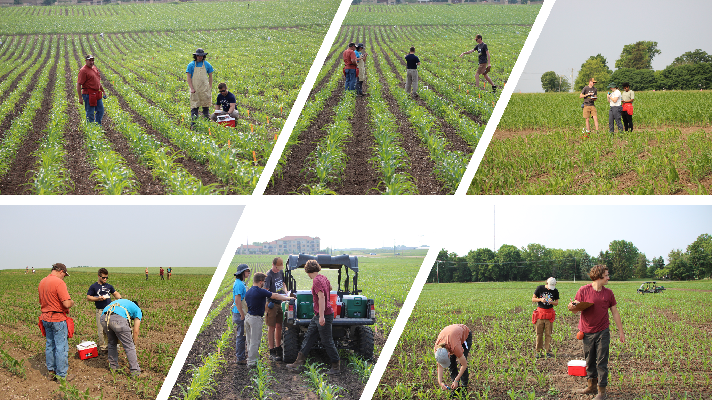

Slide 11
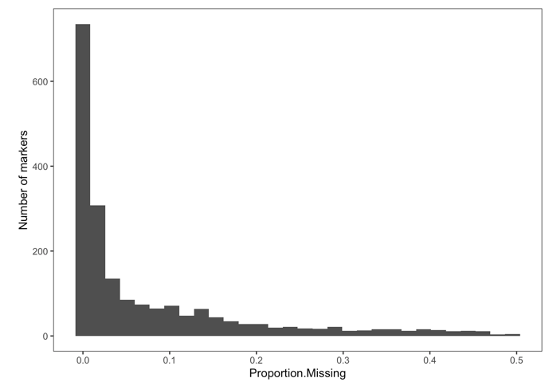
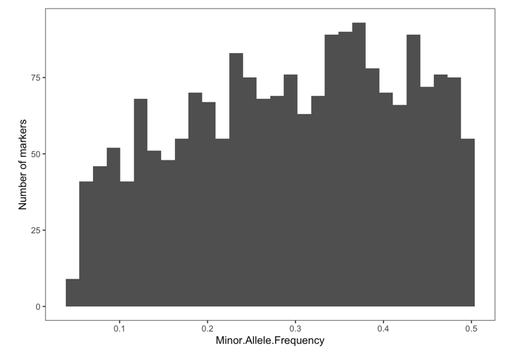
Quality Control of Returned Marker Data
Missing Data
* Most markers <10% missing
Received data for 2,491 markers
Performed Quality Control based on:
MAF: > 0.05
Proportion Missing: < 0.50
Proportion Heterozygous: < 0.50
Proportion matching variant calls from other data: > 0.50
Maintain 1,959 for investigation
MAF

Slide 12
Marker Origin and Annotation– 2,490 in initial data
Putative Phenotypic Associations of Markers
Gene Association of Marker
Phenotype | Number
Polymorphic Among Parents of Diverse Biparental Pops. | 693
Yield | 542
Plant and Ear Height | 422
Ear, Kernel, and Cob Morphology | 390
Flowering Time | 322
Tassel Architecture | 89
Disease Resistance | 25
Root Architecture | 3
Other | 3
Gene Position | Number
Core Gene | 2175
Intergenic | 192
Near-Core Gene | 109
Dispensable Gene | 14

Slide 13
Marker Origin and Annotation– 1,959 after QC
Putative Phenotypic Associations of Markers
Gene Association of Marker
Phenotype | Number
Polymorphic Among Parents of Diverse Biparental Pops. | 544
Yield | 432
Plant and Ear Height | 313
Ear, Kernel, and Cob Morphology | 329
Flowering Time | 244
Tassel Architecture | 70
Disease Resistance | 21
Root Architecture | 3
Other | 3
Gene Position | Number
Core Gene | 1720
Intergenic | 143
Near-Core Gene | 86
Dispensable Gene | 10

Slide 14
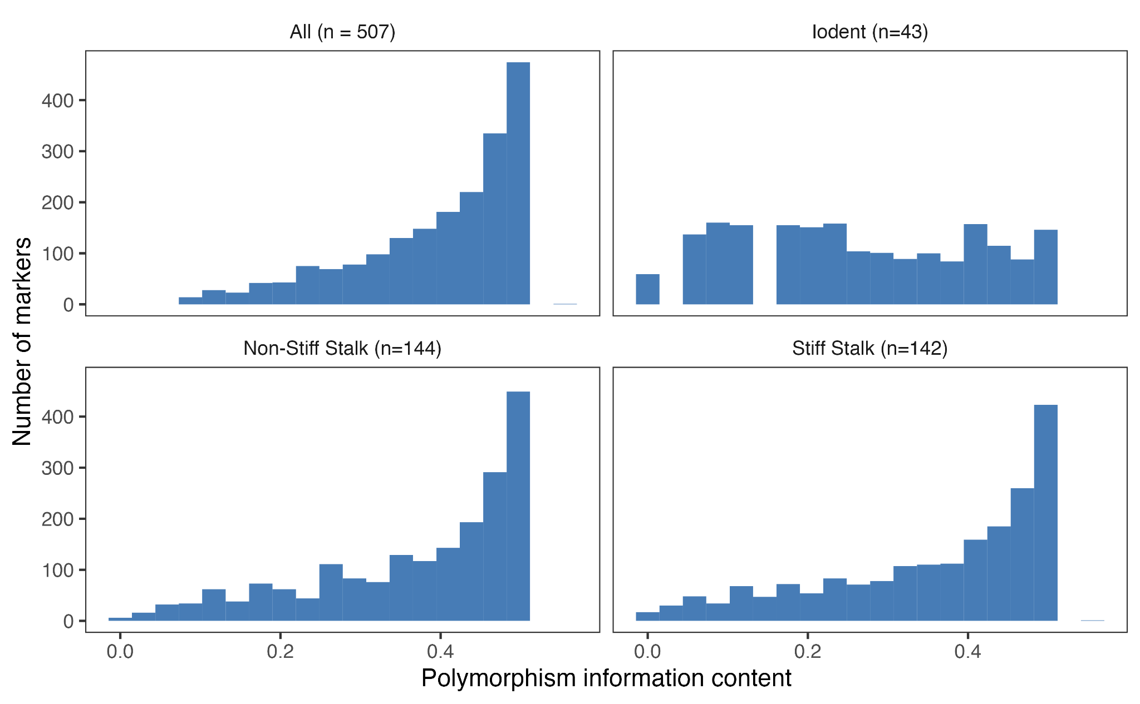
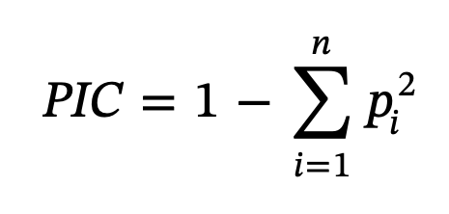
Informativeness of markers in dent maize diversity panel
All (n=507)
Iodent (n=43)
(Botstein et al., 1980)
NSS (n=144)
SS (n=144)
Polymorphism Information Content
Notes:
Polymorphism Information Content of a molecular marker. Heterozygosity or genetic diversity estimate in a population taking into account the frequency of homozygous individuals
The one high PIC value is caused by a marker with 3 alleles

Slide 15
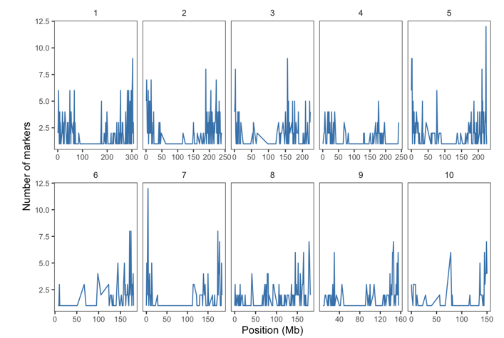
Distribution of markers across the genome
Average spacing between adjacent markers is 1.06 Mb
Largest gap is 43.42 Mb
Gaps primarily in centromere regions so likely small cM gaps
Average distance between adjacent markers
B73 V5 Reference Genome
Chr. | 1 | 2 | 3 | 4 | 5 | 6 | 7 | 8 | 9 | 10
Distance (kb) | 966.80 | 919.47 | 1,082.48 | 1,456.06 | 888.34 | 1,374.18 | 1,106.69 | 874.77 | 1,082.86 | 1,332.74

Slide 16
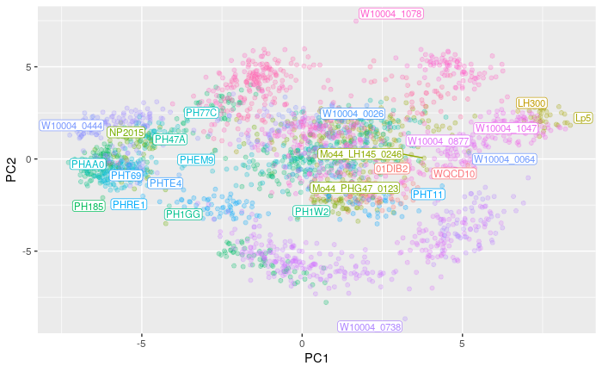
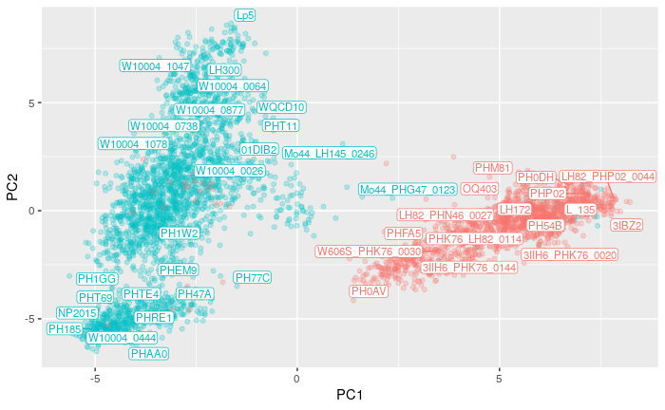
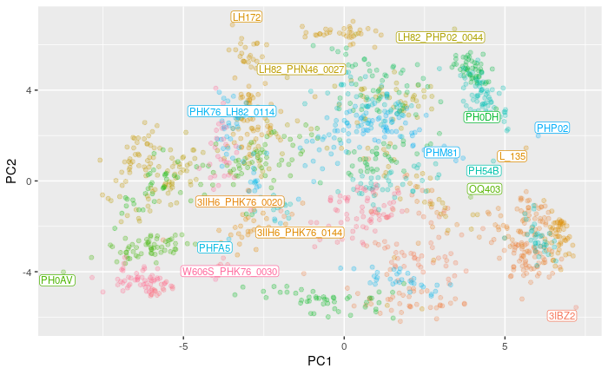
Diversity of 4,095 “Early 100” Families

Slide 17
Utility in “Early 100” Bi-Parental Populations
Criterion | Min | Median | Max
Segregating Sites | 382 | 690 | 854
Minor Allele Frequency | 0.23 | 0.41 | 0.44
Proportion Heterozygous | 0.20 | 0.28 | 0.35
Notes:
Using the 1959 marker set to stay consistent with rest of the presentation
Plants genotyped were F3 plants -> expected Heterozygous 0.25

Slide 18
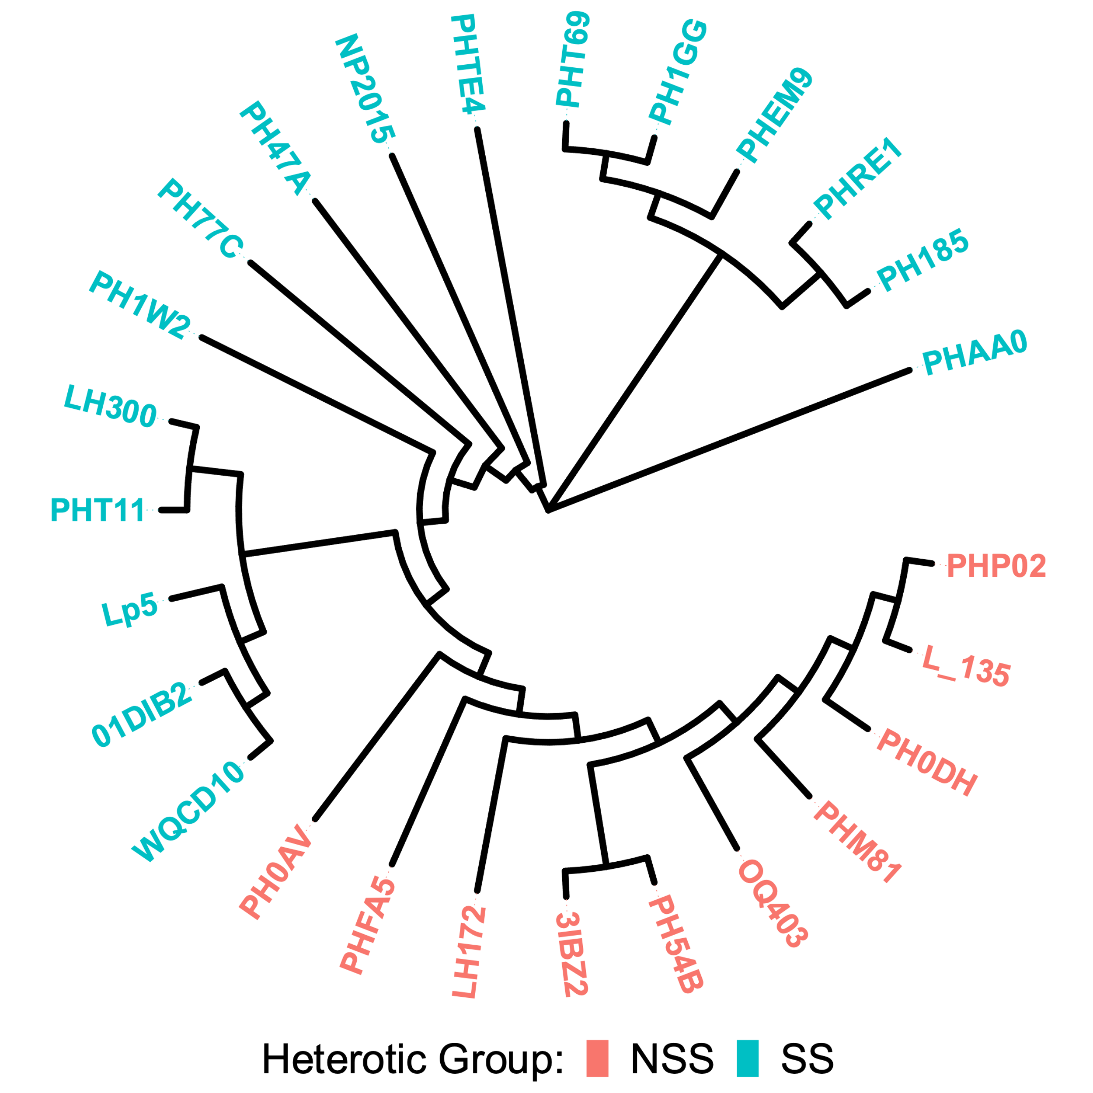
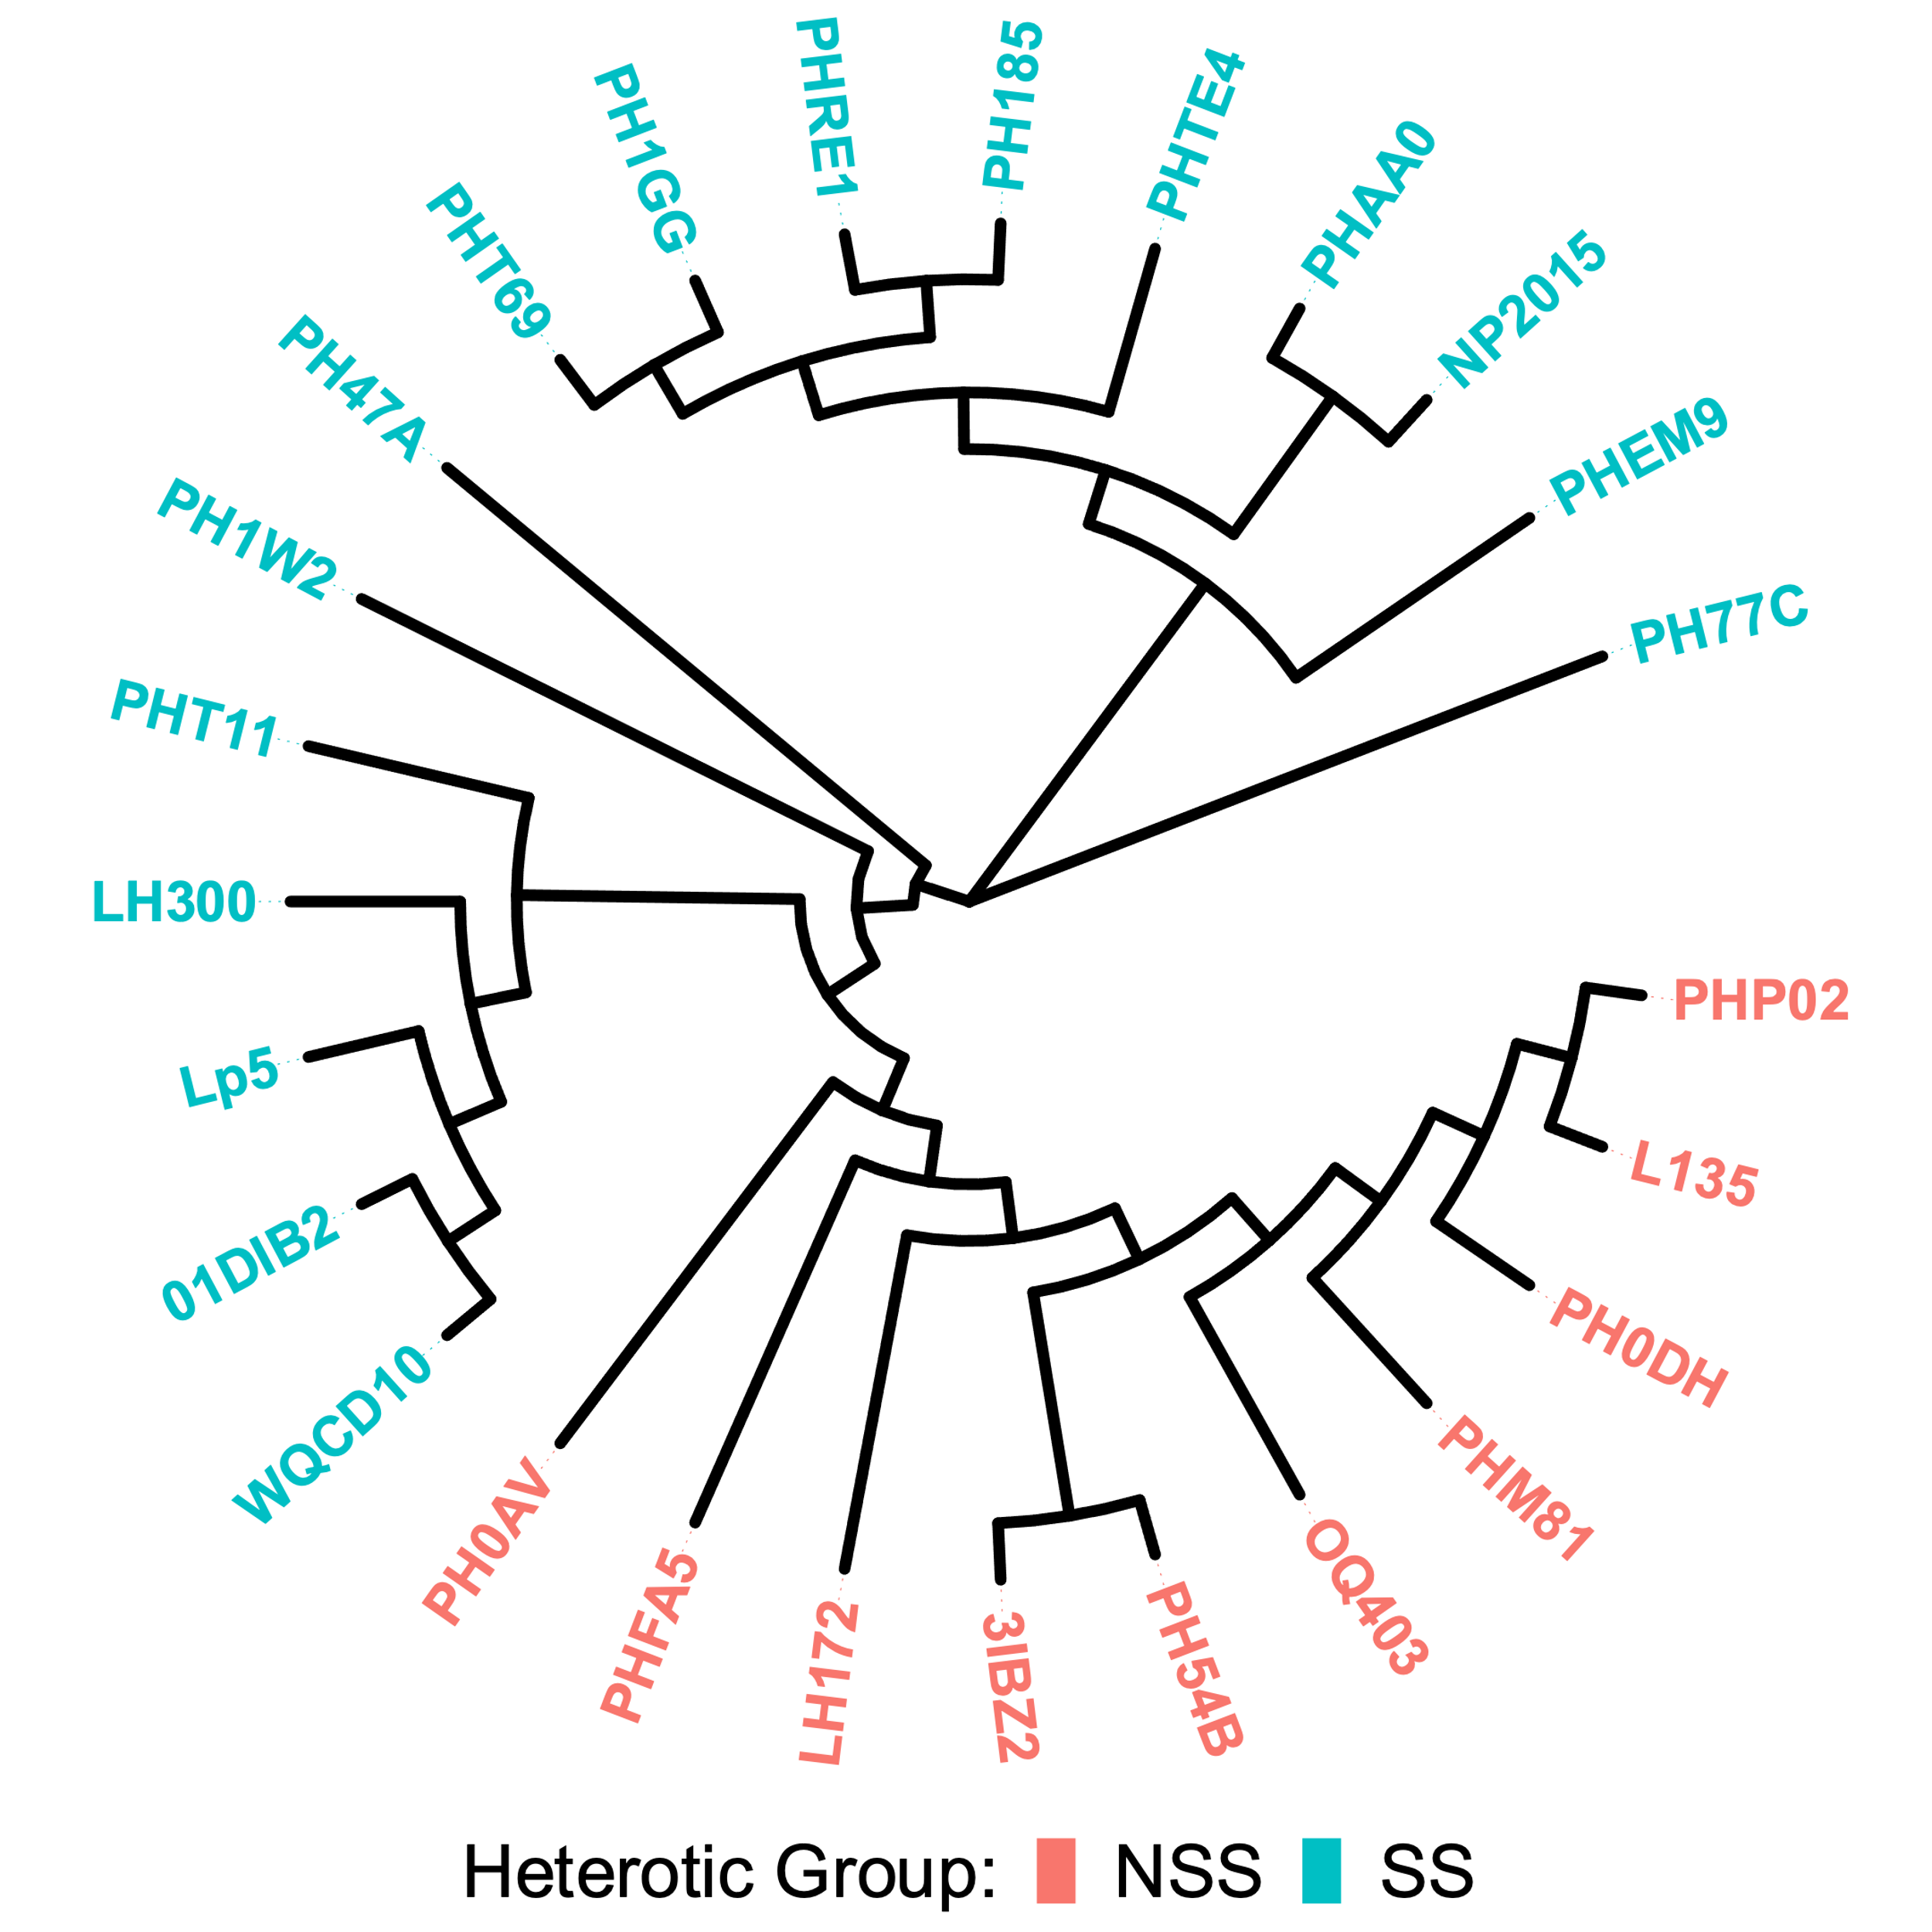
Germplasm comparison with this marker set versus a larger set
1959 SNPs
52,923 SNPs
Notes:
Grouping looks similar?!
Change L135 name?

Slide 19
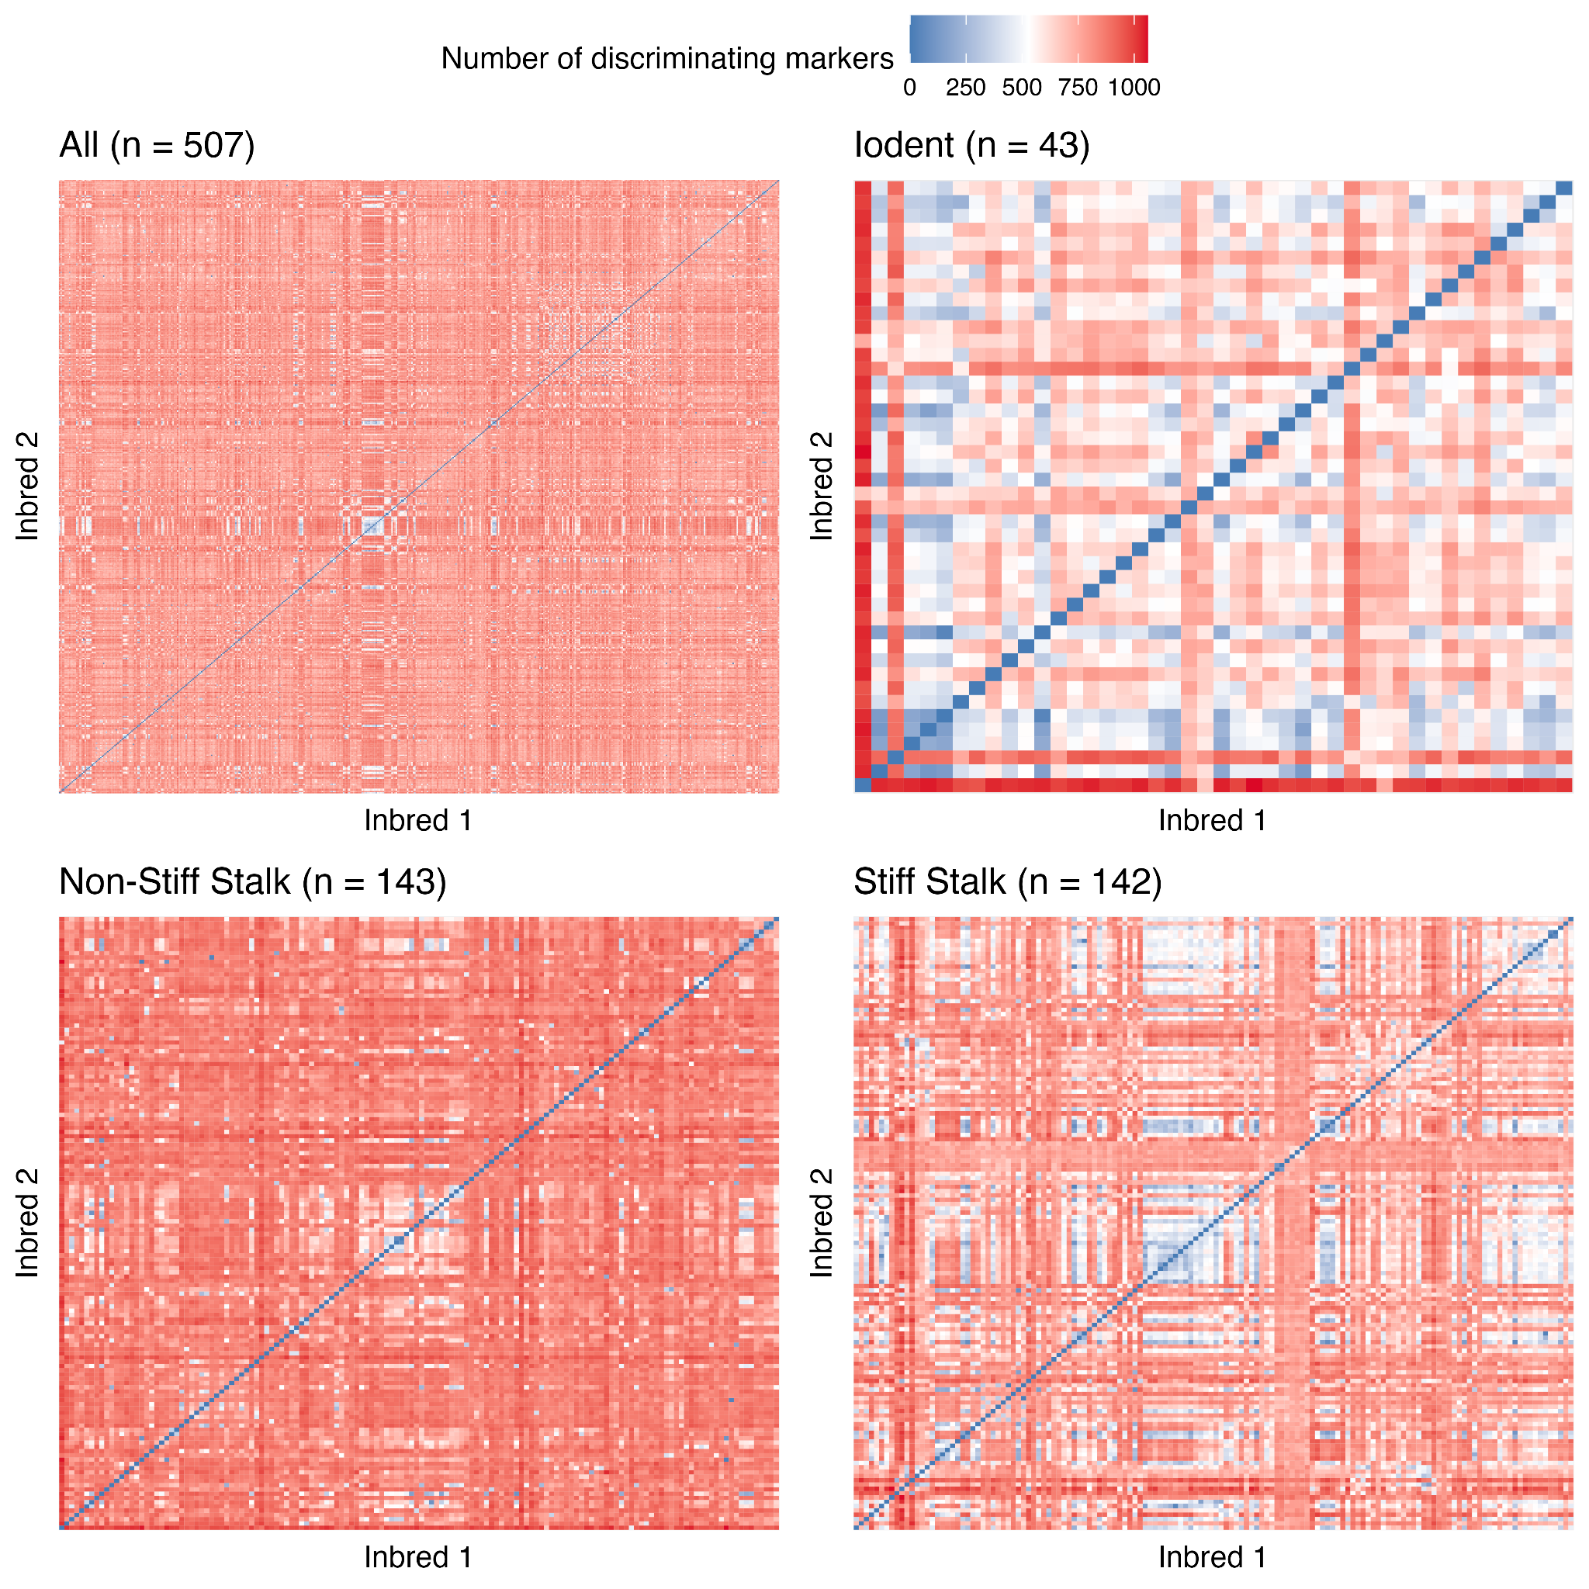
Number of markers differentiating pairs of inbreds
Mo17 and Seagull Seventeen (3 markers)
Q381 and PH207 (22 markers)
B14 and LH143 (236 markers)
Mo17 and B14 (933 markers)

Slide 20
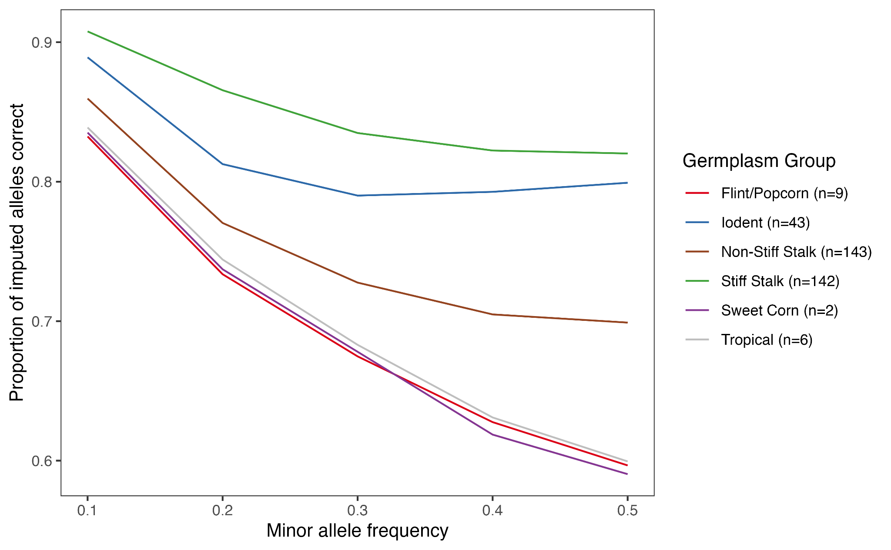
Utilizing markers to upgrade to high-density SNPs by imputation
A leave-one-out imputation experiment using the Wisconsin Diversity Panel (WiDiv) variant data from Qiu et al. (2021) as a reference panel.
One member of the WiDiv was withheld from the reference panel at a time, and its genotype at 3.1 M variants was imputed based on the 1,959 Agriplex markers.
Imputation was performed with Beagle 5.4 (Browning et al., 2018) with the reference panel specified and otherwise default settings.
Notes:
This turns out not to work very well in the WiDiv, which is perhaps not surprising. It would be nice to try this in something more like a breeding population, but I’m not sure we have a good data set to test that because of limited overlap with the Agriplex markers and imputation error in the MAGIC and G2F data
Maybe the best path would be to call new, high quality variants on the exome capture data, although that will take some time. We could also try this on Kathryn’s existing PHG data, although there would be 2 confounded sources of imputation error there

Slide 21
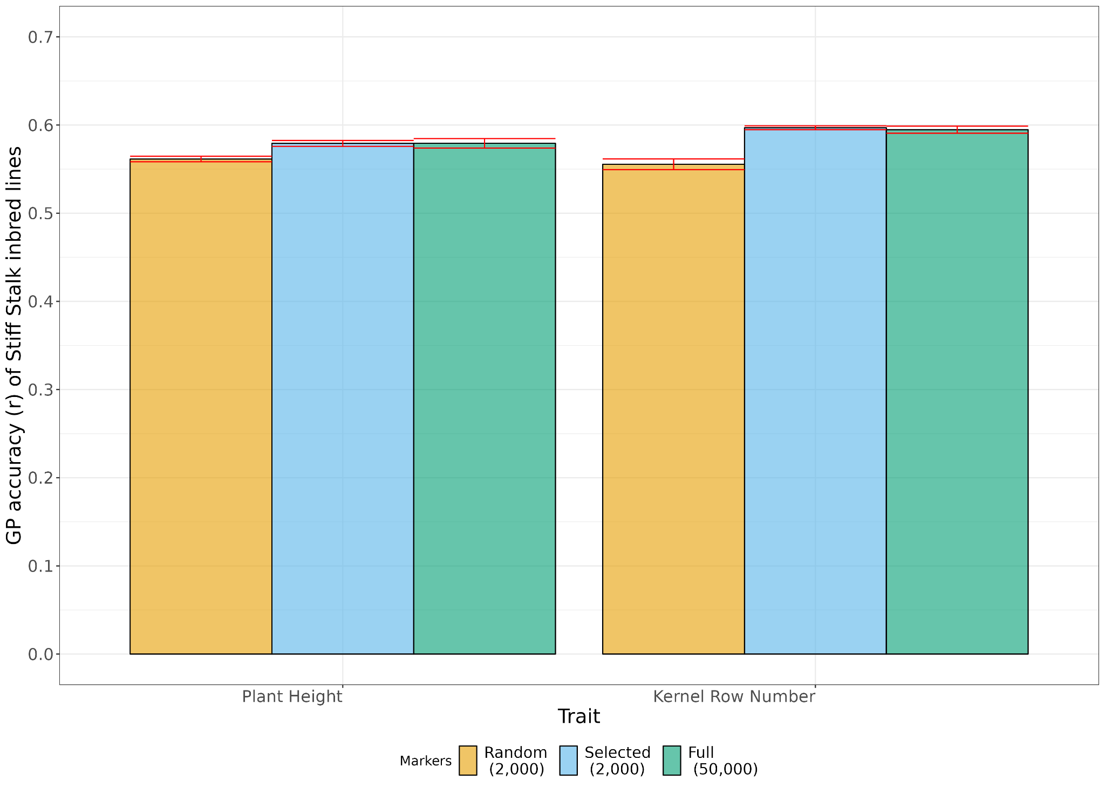
Markers in the SNP panel can be used to develop effective Genomic prediction models
Genomic Prediction was as accurate with 1,959 Agriplex markers as 50,000 markers, and more accurate than 2,000 random markers
The reduced selected marker set improved computation efficiency of GP model training
Plant Height
Kernel Row #
Random 2,000
Agriplex 1,959
Random 2,000
Total 50,000
Agriplex 1,959
Total 50,000
Constant training set size of 476 Stiff Stalk DH lines
Notes:
Predict using a large set of markers and then using this, and reducing the set of markers. Plot the accuracy of prediction by set of markers

Slide 22
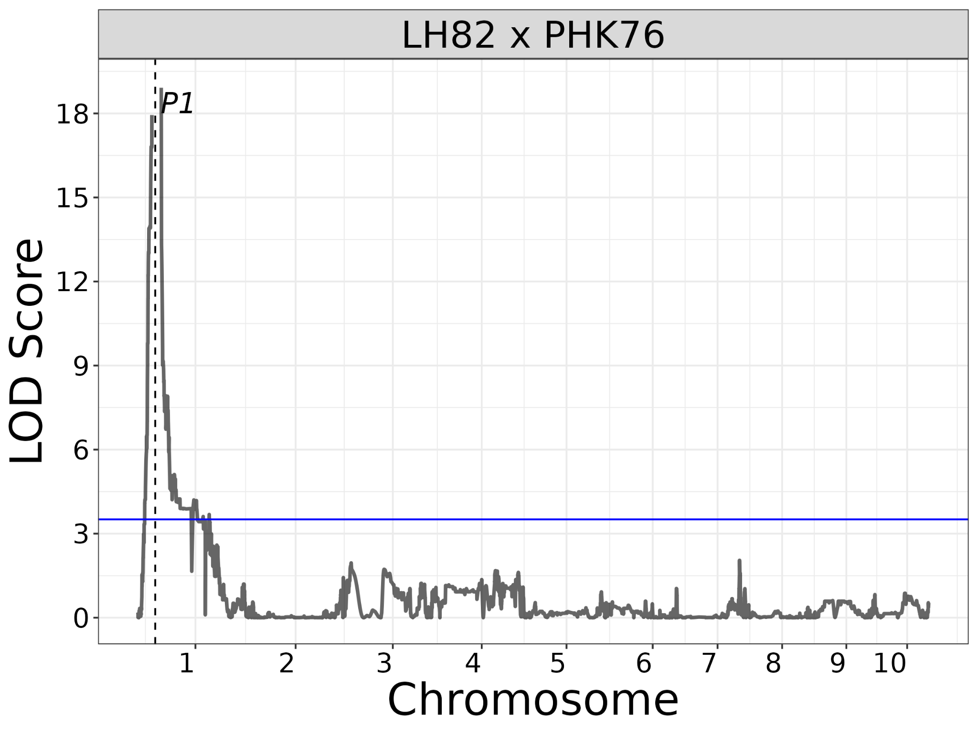
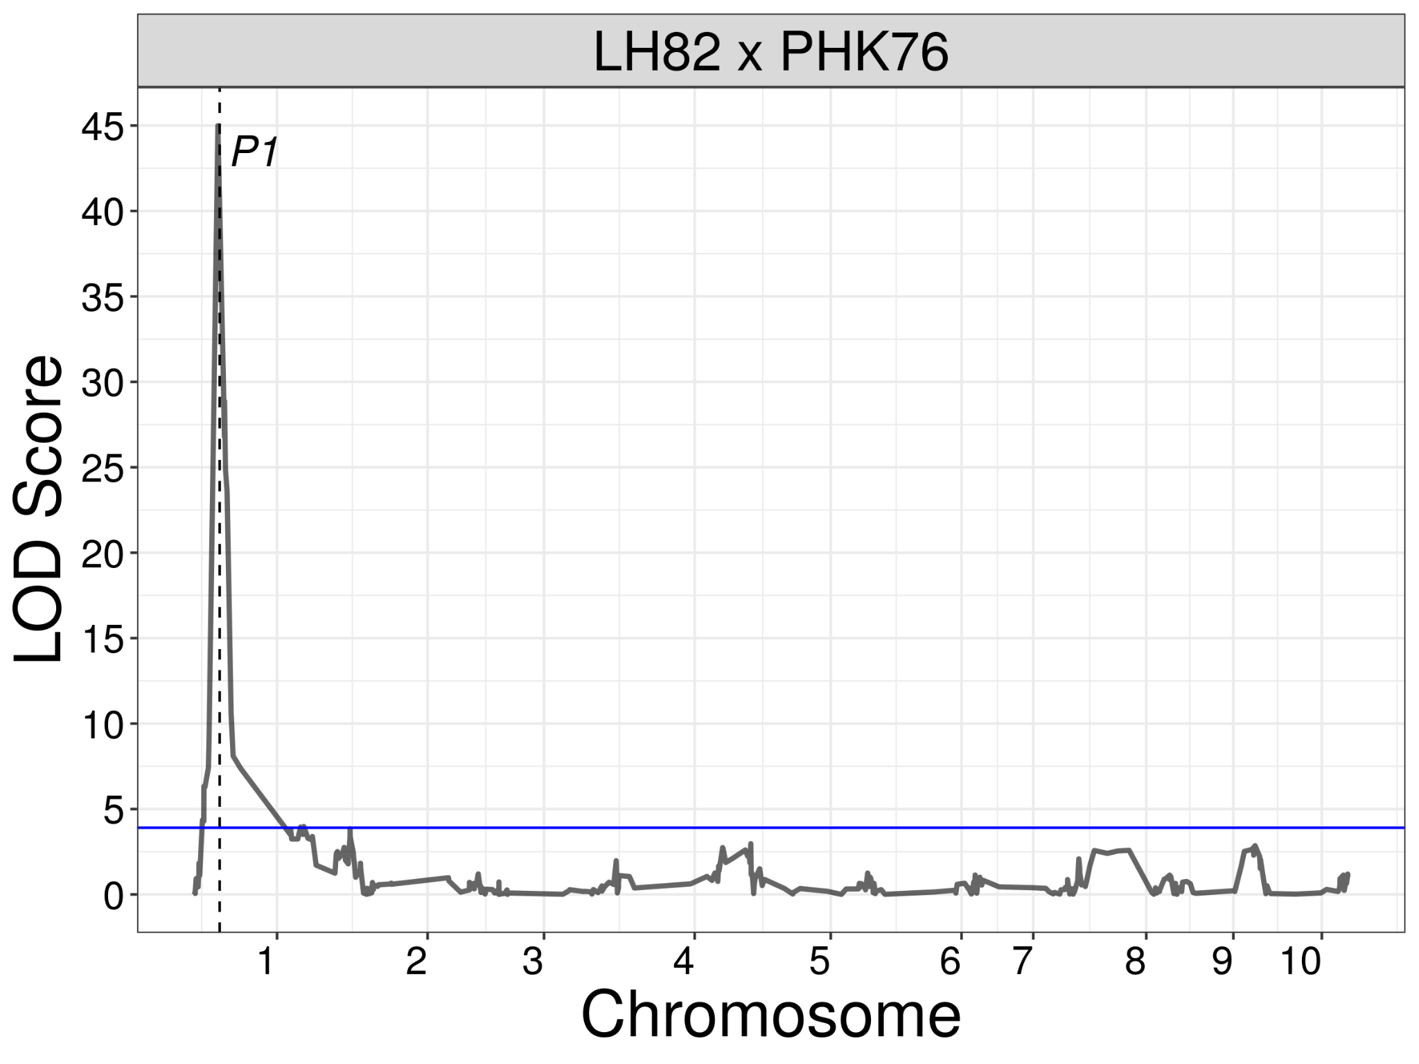
Example of use of the assay for Genetic mapping - Cob glume pigmentation
QTL for cob glume pigmentation using 14,296 GBS SNPs
QTL peak for cob glume based on single marker regression with 427 SNPs in maize panel
(Schoemaker et al., 2023)

Slide 23
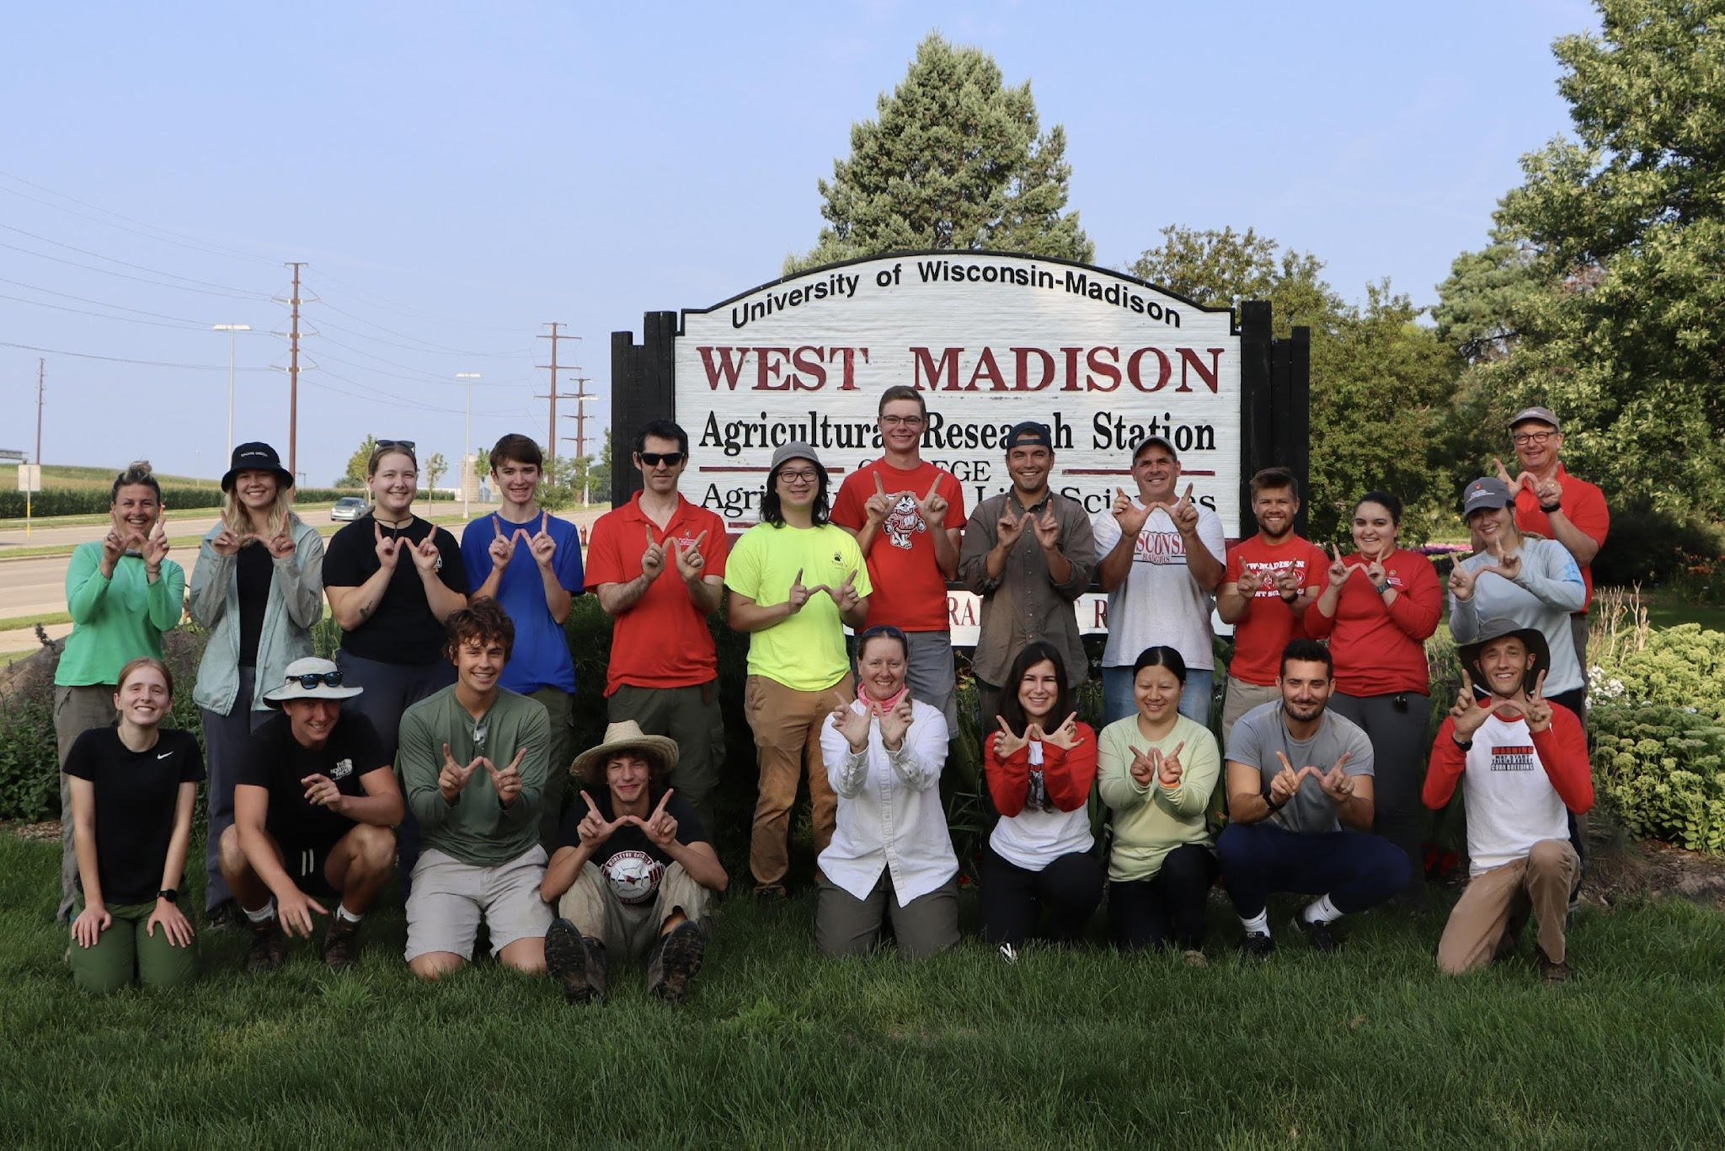
The UW Field Corn Breeding team – happy with the Agriplex markers!

